Slide 1

Diamond deals
Unraveling the Metrics and Money in MLB Player Transactions
Hayden Ravert
Woz U

Slide 2

Background
Hayden Ravert
B.S. Astrophysics From Towson University
10 years of Retail Management
A lifetime of watching and analyzing Baseball

Slide 3

Project Question
What is the financial value of free agent players in Major League Baseball?

Slide 4
Determining A Players Value
Player Position
Pitcher vs. Position Player?
Player Statistics
What are baseball statistics?
Which statistics should be used?
Statistics vs. Salary
How do the statistics influence salary?
Notes:
Pitcher – Starting or Relief
Position Player – All other positions other than pitcher C, 1B, RF, etc.
They also bat
Salary we will look at is the average yearly salary over the course of a contract

Slide 5
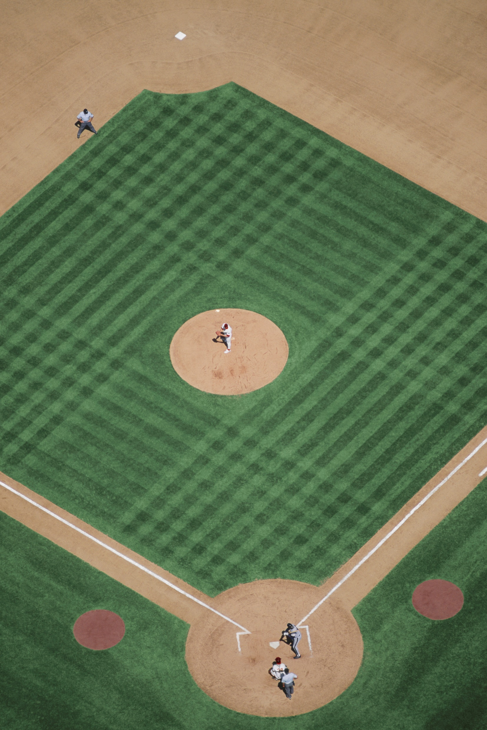
Pitcher
Stats
ERA – Earned Run Average
Lower Better
WHIP – Walks and Hits per Inning
Lower Better
IP – Innings Pitched
Higher Better
W – Wins
Higher Better
SV – Saves
Higher Better
Notes:
ERA - Number of Runs per nine innings
WHIP - How well a pitcher keeps players off base
IP - Number of innings pitched over a season
W - Pitcher of record with a lead after five innings when starting or most effective relief pitcher
SV - Pitcher who gets the last three outs with a lead of no more that three runs

Slide 6
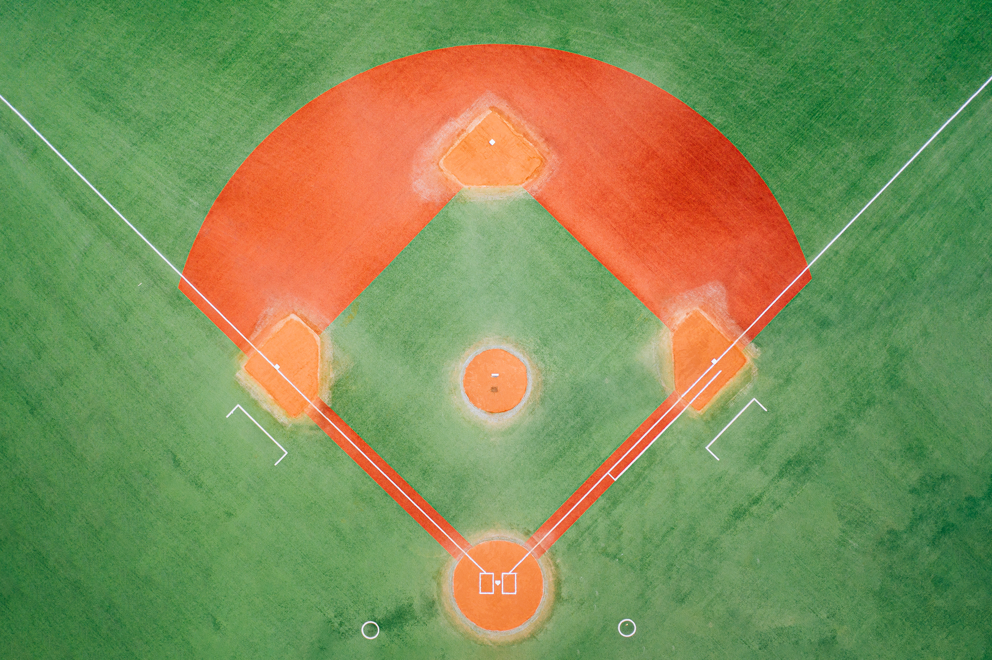
Position Players
Stats
H – Hits
Higher Better
RBI – Runs Batted In
Higher Better
HR – Home Runs
Higher Better
AVG – Batting Average
Higher Better
OPS – On Base Percentage Plus Slugging
Higher Better
Notes:
A position players stats are mostly reflected in how well they bat
H- When a player hits the ball in fair territory and reaches base
RBI - When a player's plate appearance results in a run scored
HR - When a player scores who hit the ball in fair territory
AVG - Total Hits divided by Total At Bats
OPS - How well a hitter can reach base and how well he can hit for average and power
They also have other stats based on how well they play the field but are mostly overlooked

Slide 7
WAR
Wins Above Replacement
Measures a player’s win value versus a replacement player at the same position(usually a Minor League replacement) (Higher Better)
WAR = (Batting Runs + Base Running Runs +Fielding Runs + Positional Adjustment + League Adjustment +Replacement Runs) / (Runs Per Win)
WAR = [[([(League “FIP” – “FIP”) / Pitcher Specific Runs Per Win] + Replacement Level) * (IP/9)] * Leverage Multiplier for Relievers] + League Correction
Notes:
WAR is a stat that both types of players have however it is calculated differently
Position based on batting
Pitcher based on how well they pitch

Slide 8

Methods

Slide 9
DATA Gathering
All data from spotrac.com
Free Agent Signings of seasons 2019-2023
Player, Position, Age, Bats, Throws, Team From, Team To, Years Signed, Total Salary, Average Yearly Salary
Stats of players from seasons 2018-2022
H, RBI, HR, AVG, OPS, IP, ERA, WHIP, W, SV, WAR
Starting with 679 Samples

Slide 10

Data Manipulation
Add Player Id column
Split the data into Pitcher and Position Player
Created dummy variables to match positions to separate
Drop irrelevant columns
Position, Total Salary, Bats, Throws, From, To
Drop missing values or change to 0
Pitchers
Age, Average Salary, Innings Pitched, ERA, WHIP, Wins, Saves, WAR
Sample Size 331
Position Players
Age, Average Salary, Hits, RBI, HR, AVG, OPS, WAR
Sample Size 278
Notes:
Position Dummy variable are split into player position on the field, 1=Pitcher, 2=Catcher, 3=1st Base, etc.
What hand they throw with or side of the plate they hit from is irrelevant for the time being
Also, they're last team and new team is also irrelevant.
Any N/A Salaries or WAR’s listed need to be dropped
N/A Saves is changed to 0
Minimum of 85 samples needed was found after looking at G Power.

Slide 11
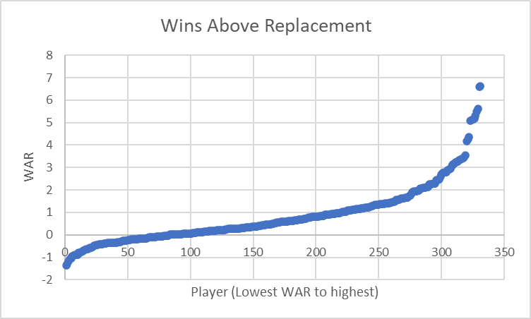
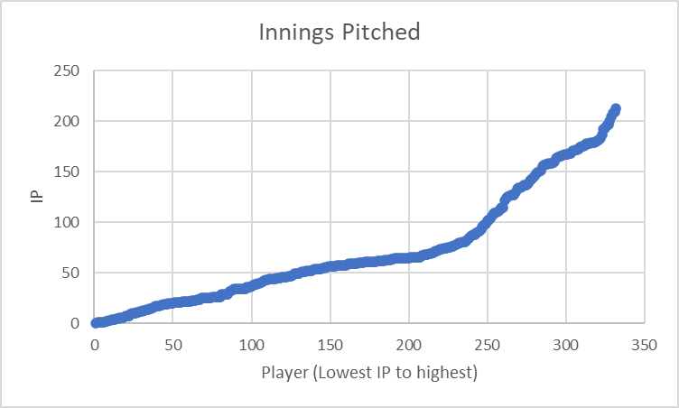
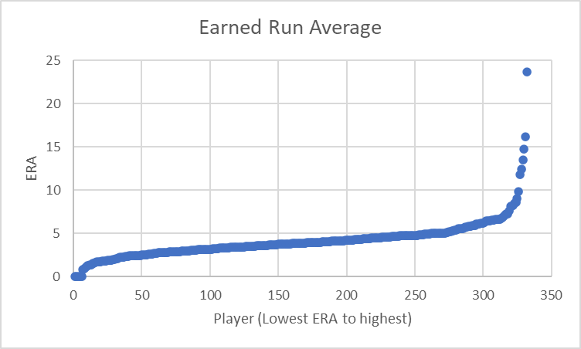
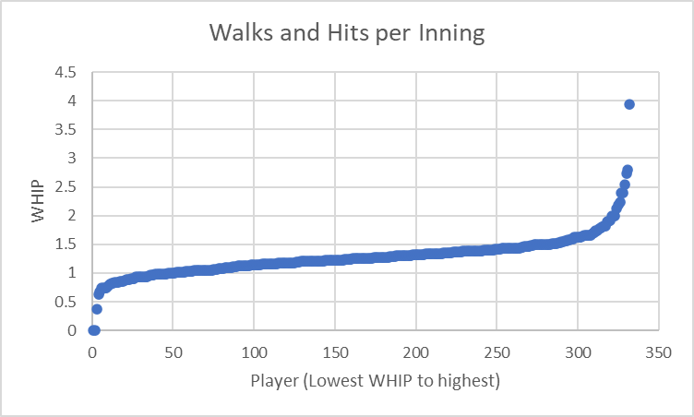
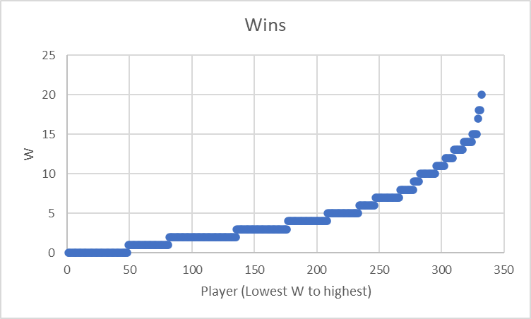
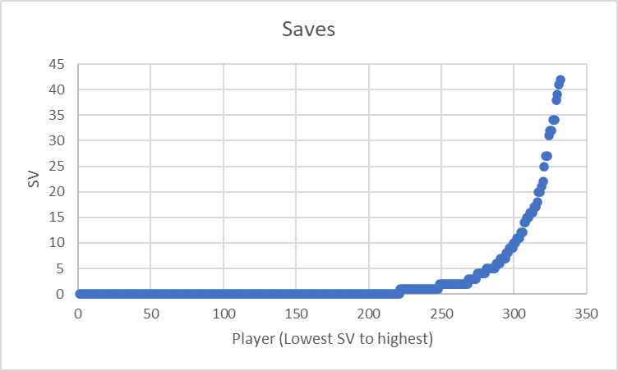
Pitcher Data Exploration
Distribution similarity of baseball statistics
Notes:
Plotting the Stats in numerical order we find non-linear structure to the graphs
Some look exponential the others look polynomic

Slide 12
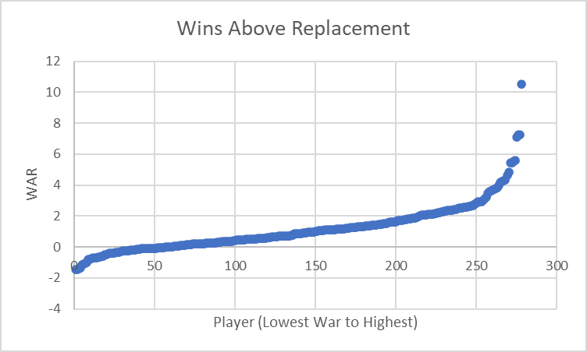
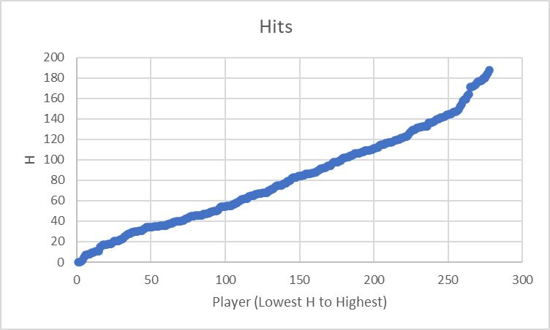
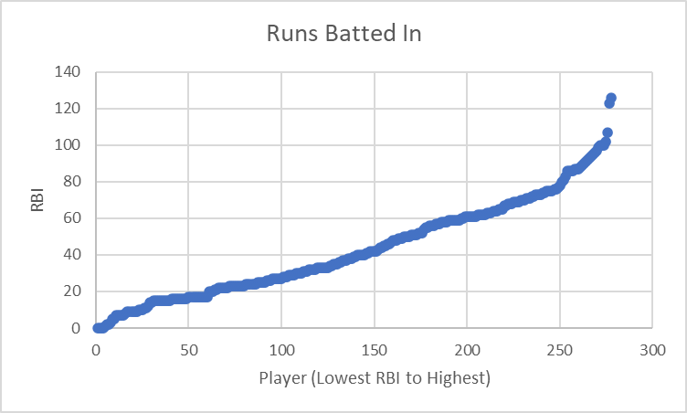
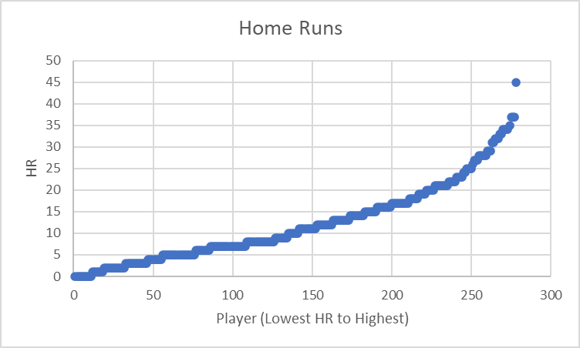
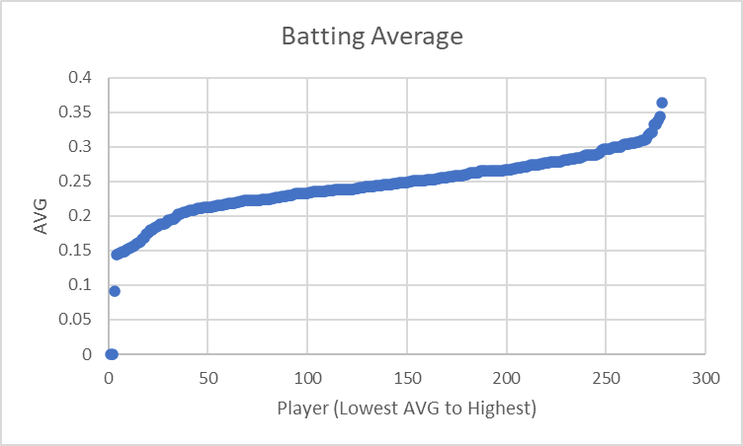
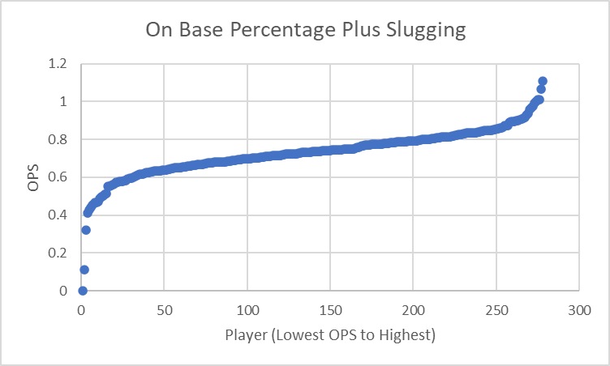
Position Player Data Exploration
Distribution similarity of baseball statistics
Notes:
Same with batting stats

Slide 13
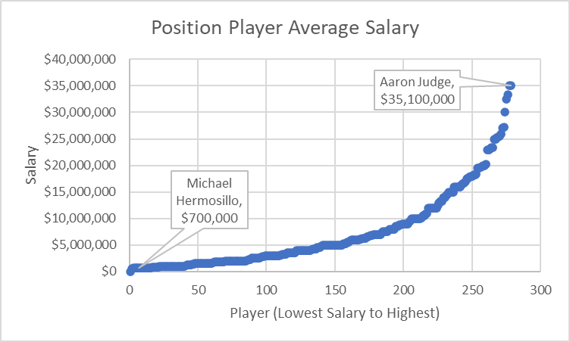
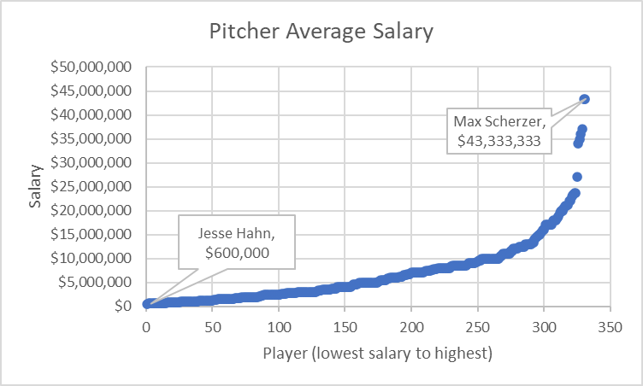
Salary Data Exploration
Shape of the graphs look exponential
Notes:
Now our DV
And looking at Salary plotted in numerical order we find it looks exponential.
Unfortunately, I realized this within the last week.

Slide 14
Analysis Methods
Stepwise Exponential Regression
Method used to model the relationship between a dependent variable and one or more independent variables that adds or removes predictor variables from the model in a step-by-step fashion.
Mediation
Analysis used to explore the indirect effect of an independent variable on a dependent variable through a variable with a causal relationship.
Moderation
Analysis that examines the influence of a third variable on the strength or direction of the relationship between an independent variable and a dependent variable.
Notes:
Stepwise Regression – is run in R and as it is processed over iterations it gauges how strong a relationship the dependent variable has with all other variable
This then can remove variables that don’t affect the dependent variable significantly
Produces coefficients that tell us how Salary changes with respect to each variable
Mediation – Indirect keyword
Not as important but good to know
Regression of each individual variable with respect to WAR and compared to WAR + variable with respect to Salary
Moderation – Direct effect
Regression of WAR * each variable with respect to the Salary
This if significant is added to our formula for Salary

Slide 15

Results

Slide 16
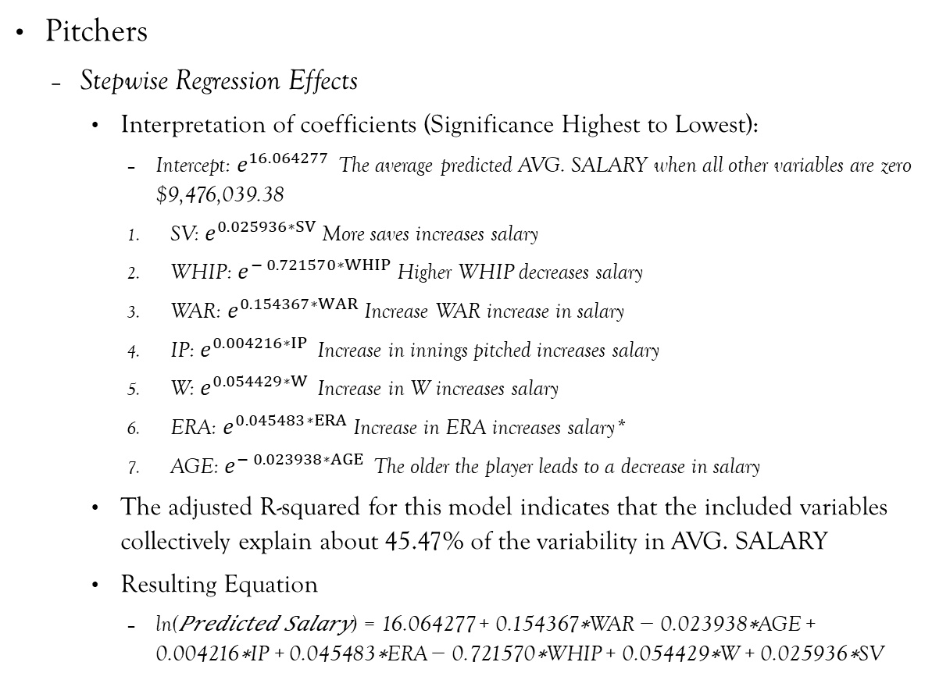
Exponential Regression Results
Pitchers
Stepwise Regression Effects
Interpretation of coefficients (Significance Highest to Lowest):
Intercept: $e^{16.064277 }$The average predicted AVG. SALARY when all other variables are zero $9,476,039.38
SV: $e^{0.025936∗SV}$More saves increases salary
WHIP: $e^{− 0.721570∗WHIP}$Higher WHIP decreases salary
WAR: $e^{0.154367∗WAR}$Increase WAR increase in salary
IP: $e^{0.004216∗IP }$Increase in innings pitched increases salary
W: $e^{0.054429∗W }$Increase in W increases salary
ERA: $e^{0.045483∗ERA}$Increase in ERA increases salary*
AGE: $e^{− 0.023938∗AGE }$The older the player leads to a decrease in salary
The adjusted R-squared for this model indicates that the included variables collectively explain about 45.47% of the variability in AVG. SALARY
Resulting Equation
ln⁡(𝑃𝑟𝑒𝑑𝑖𝑐𝑡𝑒𝑑 𝑆𝑎𝑙𝑎𝑟𝑦) = 16.064277 + 0.154367∗WAR − 0.023938∗AGE + 0.004216∗IP + 0.045483∗ERA − 0.721570∗WHIP + 0.054429∗W + 0.025936∗SV
Notes:
Something up with ERA
Natural log is the inverse of exponential
Our formula is not quite ready we still need to look at moderation results

Slide 17
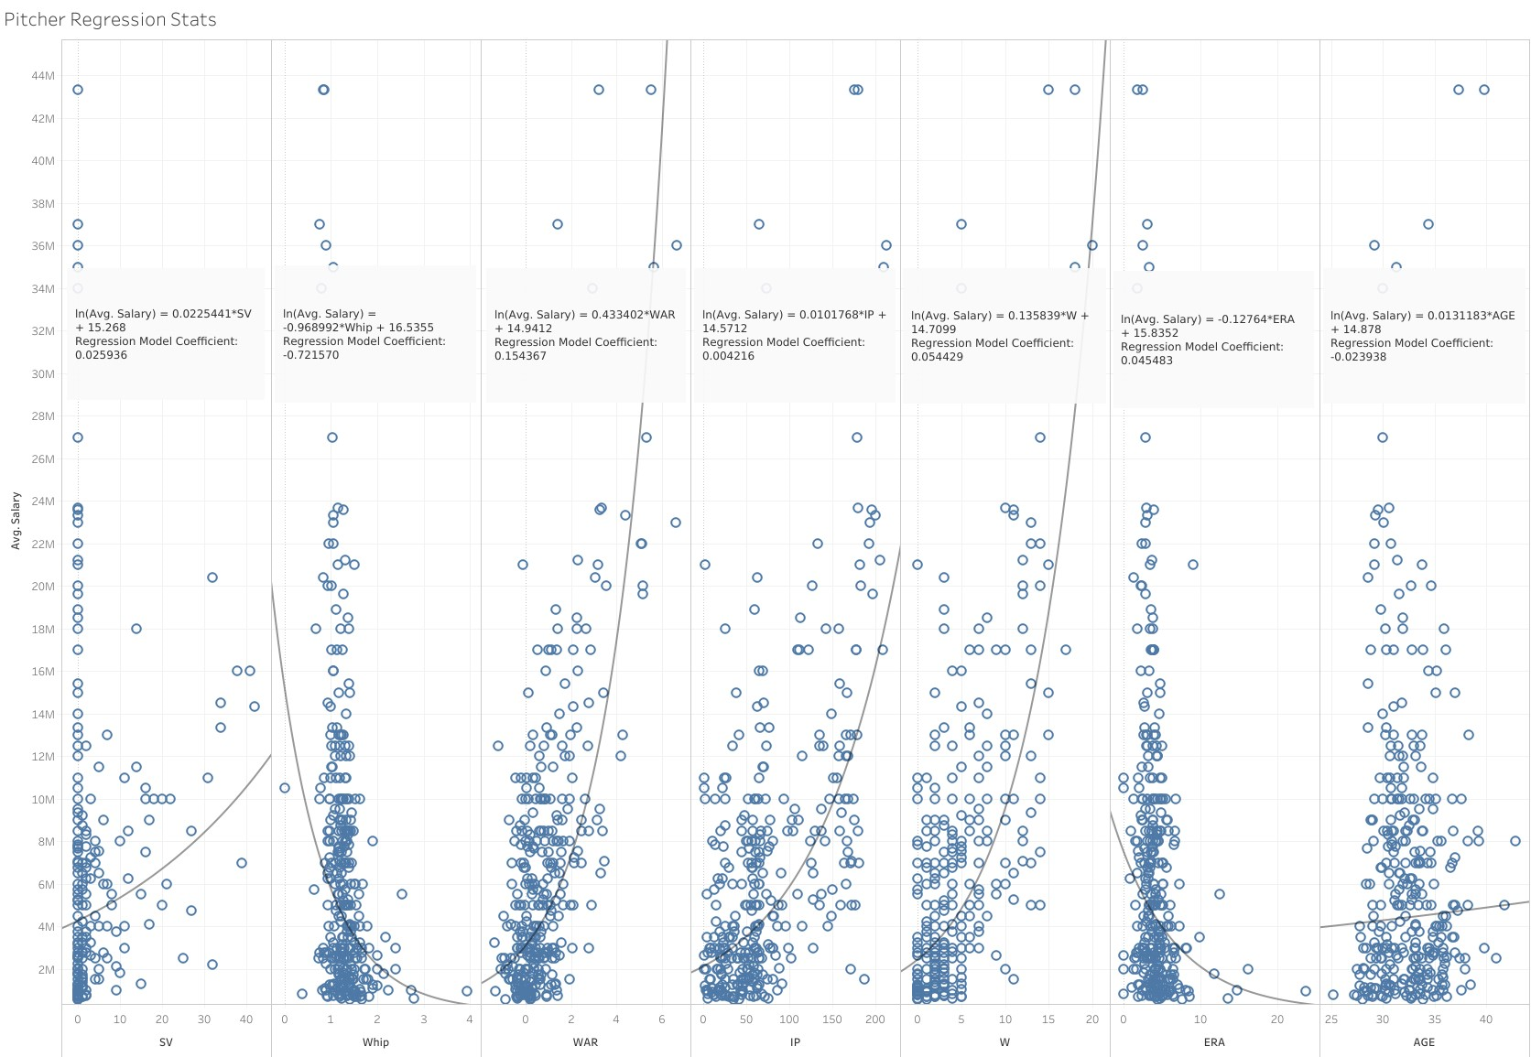
Exponential Regression coefficients vs actual Trend lines
Notes:
Here we are looking at the coefficients we just found with the exp regression compared with plotted exp trendlines on all variables

Slide 18
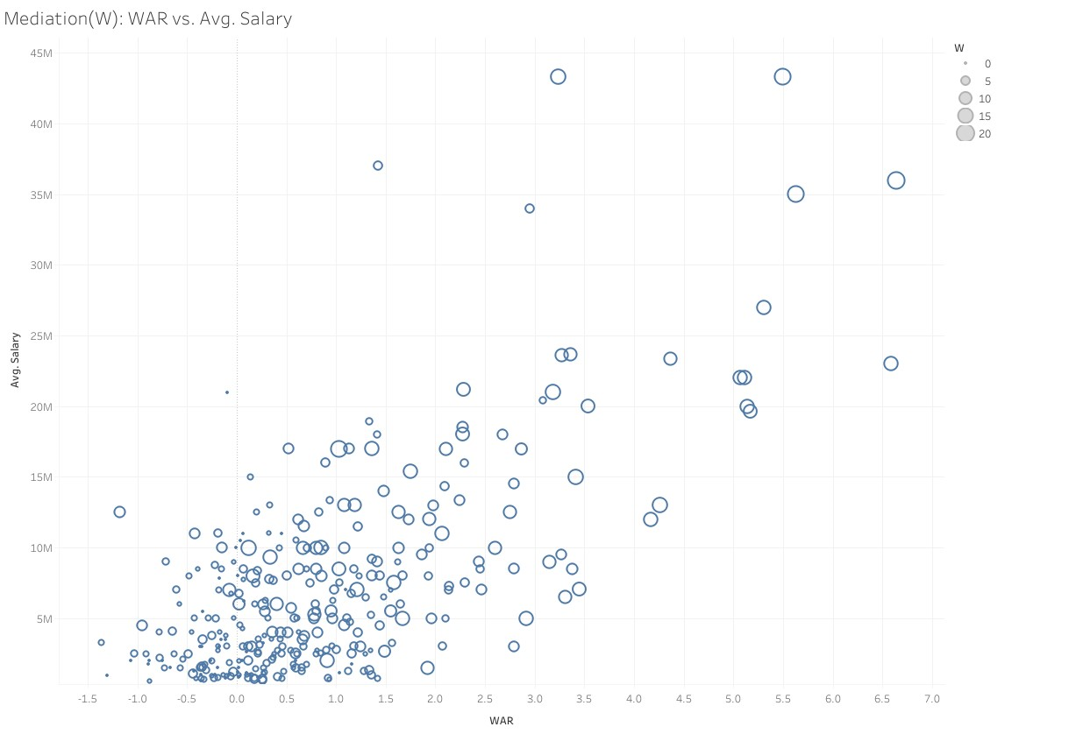
Mediation Analysis of W
Indirectly effects 45.2% WAR on Salary
Notes:
Mediation analysis assesses the mechanisms through which an independent variable influences a dependent variable.
While running mediation tests we found three variables with significance W, IP, WHIP
Analysis provides us effect of the
We find Average Causal Mediation Effect (ACME) effect with mediator
Average Direct Effect (ADE) effect with out mediator
Total Effect or overall effect
Proportion Mediated relation of ACME to the Total which is tells us how strong the mediator is
W increase with War and Salary

Slide 19

Mediation Analysis of IP
Indirectly effects 36.9% WAR on Salary
Notes:
IP increase with WAR and Salary

Slide 20
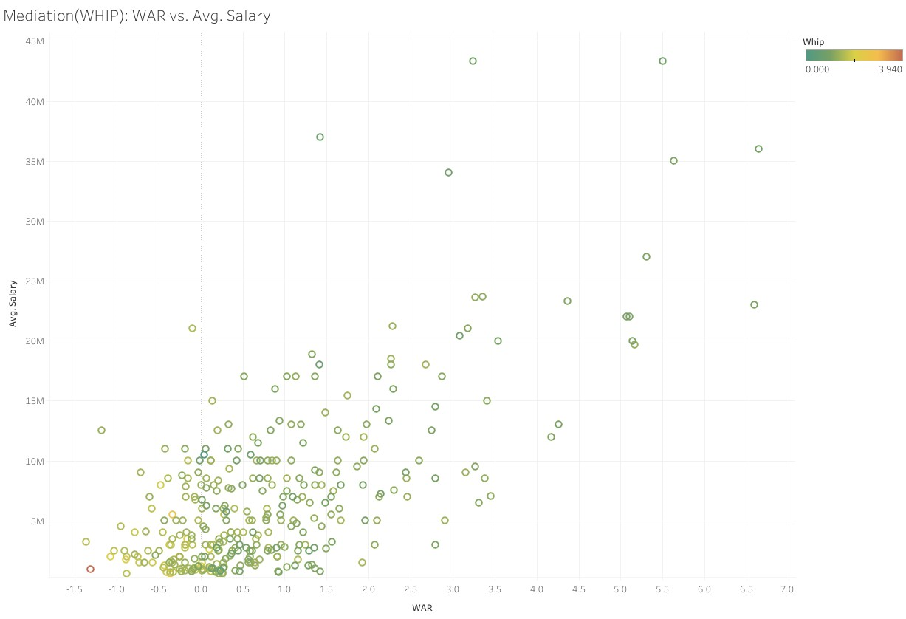
Mediation Analysis of WHIP
Indirectly effects 9.204% WAR on Salary
Notes:
Whip decrease with increase in WAR and Salary

Slide 21
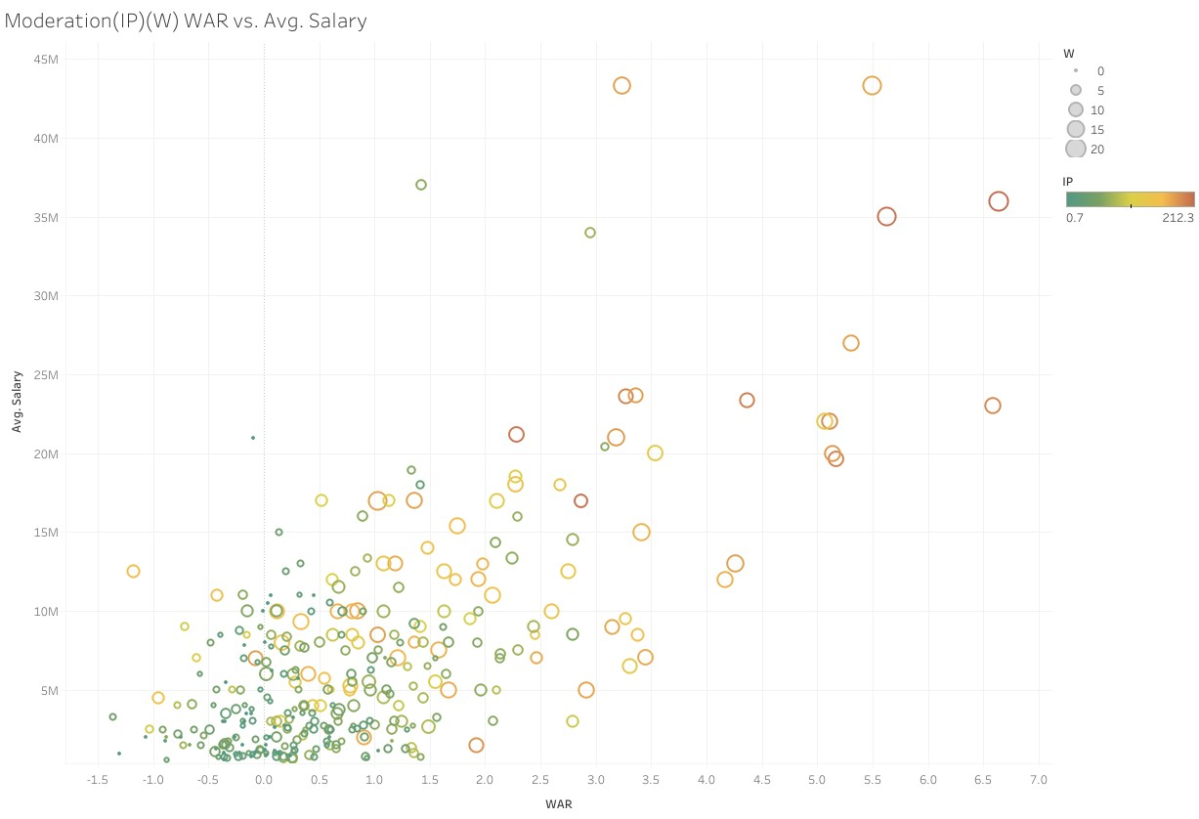
Moderation Analysis
IP
Coefficient: -0.0012974
Influences 39.66% on WAR and Salary
W
Coefficient: -0.01393
Influences 40.07% on WAR and Salary
Notes:
Moderation analysis examines whether the relationship between two variables changes based on the level of a third variable.
While running two significant moderators were found IP and W
These will be added to our equation coefficients * War * moderator

Slide 22
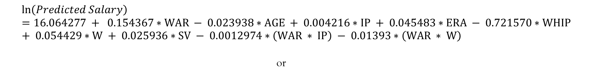
Predicted Salary Equation
$$\ln\left(Predicted Salary\right)=16.064277 + 0.154367∗WAR − 0.023938∗AGE + 0.004216∗IP + 0.045483∗ERA − 0.721570∗WHIP + 0.054429∗W + 0.025936∗SV − 0.0012974∗\left(WAR ∗ IP\right) − 0.01393∗\left(WAR ∗ W\right)$$
or
$$Predicted Salary=e^{(16.064277 + 0.154367∗WAR − 0.023938∗AGE + 0.004216∗IP + 0.045483∗ERA − 0.721570∗WHIP + 0.054429∗W + 0.025936∗SV − 0.0012974∗\left(WAR ∗ IP\right) − 0.01393∗\left(WAR ∗ W\right))}$$
Notes:
Our Formula is complete

Slide 23
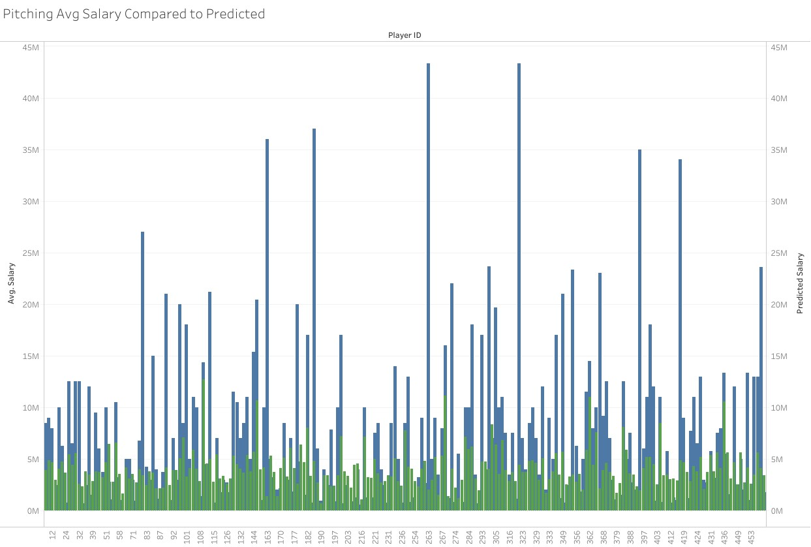
Comparison of Predicted vs. Actual
Notes:
Now we plot our predicted salary(green) with Avg Yearly Salary(blue)
So, its not perfect some are closer that others
Let's look at the error

Slide 24

Pitcher ERROR
Percent Error = ((Observed - Predicted)/Observed) *100%
Over the whole Pitching Dataset
Average Percent Error = -13.44%
Standard Deviation = 1.051311
Percent Difference = |Observed - Predicted|/[(Observed + Predicted)/2]
Over the whole Pitching Dataset
Average Percent Difference = 65%
Standard Deviation = .4261189
Notes:
Percent Error – How off our model is compared to Avg Yearly Salary - accuracy
Percent Difference – Relative difference between each value - precision
Our model underestimates the data 13% of the time
While the gap between the two sets is off by 65% yikes

Slide 25
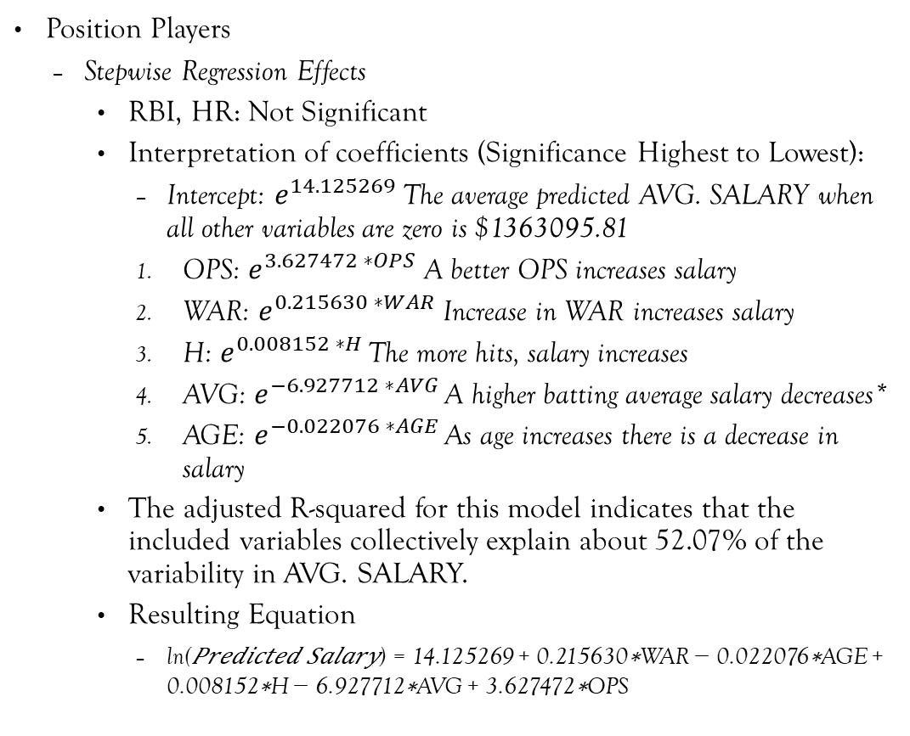
Exponential regression Results
Position Players
Stepwise Regression Effects
RBI, HR: Not Significant
Interpretation of coefficients (Significance Highest to Lowest):
Intercept: $e^{14.125269}$The average predicted AVG. SALARY when all other variables are zero is $1363095.81
OPS: $e^{3.627472 ∗OPS}$ A better OPS increases salary
WAR: $e^{0.215630 ∗WAR}$ Increase in WAR increases salary
H: $e^{0.008152 ∗H }$The more hits, salary increases
AVG: $e^{−6.927712 ∗AVG }$A higher batting average salary decreases*
AGE: $e^{−0.022076 ∗AGE }$As age increases there is a decrease in salary
The adjusted R-squared for this model indicates that the included variables collectively explain about 52.07% of the variability in AVG. SALARY.
Resulting Equation
ln⁡(𝑃𝑟𝑒𝑑𝑖𝑐𝑡𝑒𝑑 𝑆𝑎𝑙𝑎𝑟𝑦) = 14.125269 + 0.215630∗WAR − 0.022076∗AGE + 0.008152∗H − 6.927712∗AVG + 3.627472∗OPS
Notes:
On to Position Players
We do have an oddity in AVG typically we want our players to have a higher batting average

Slide 26
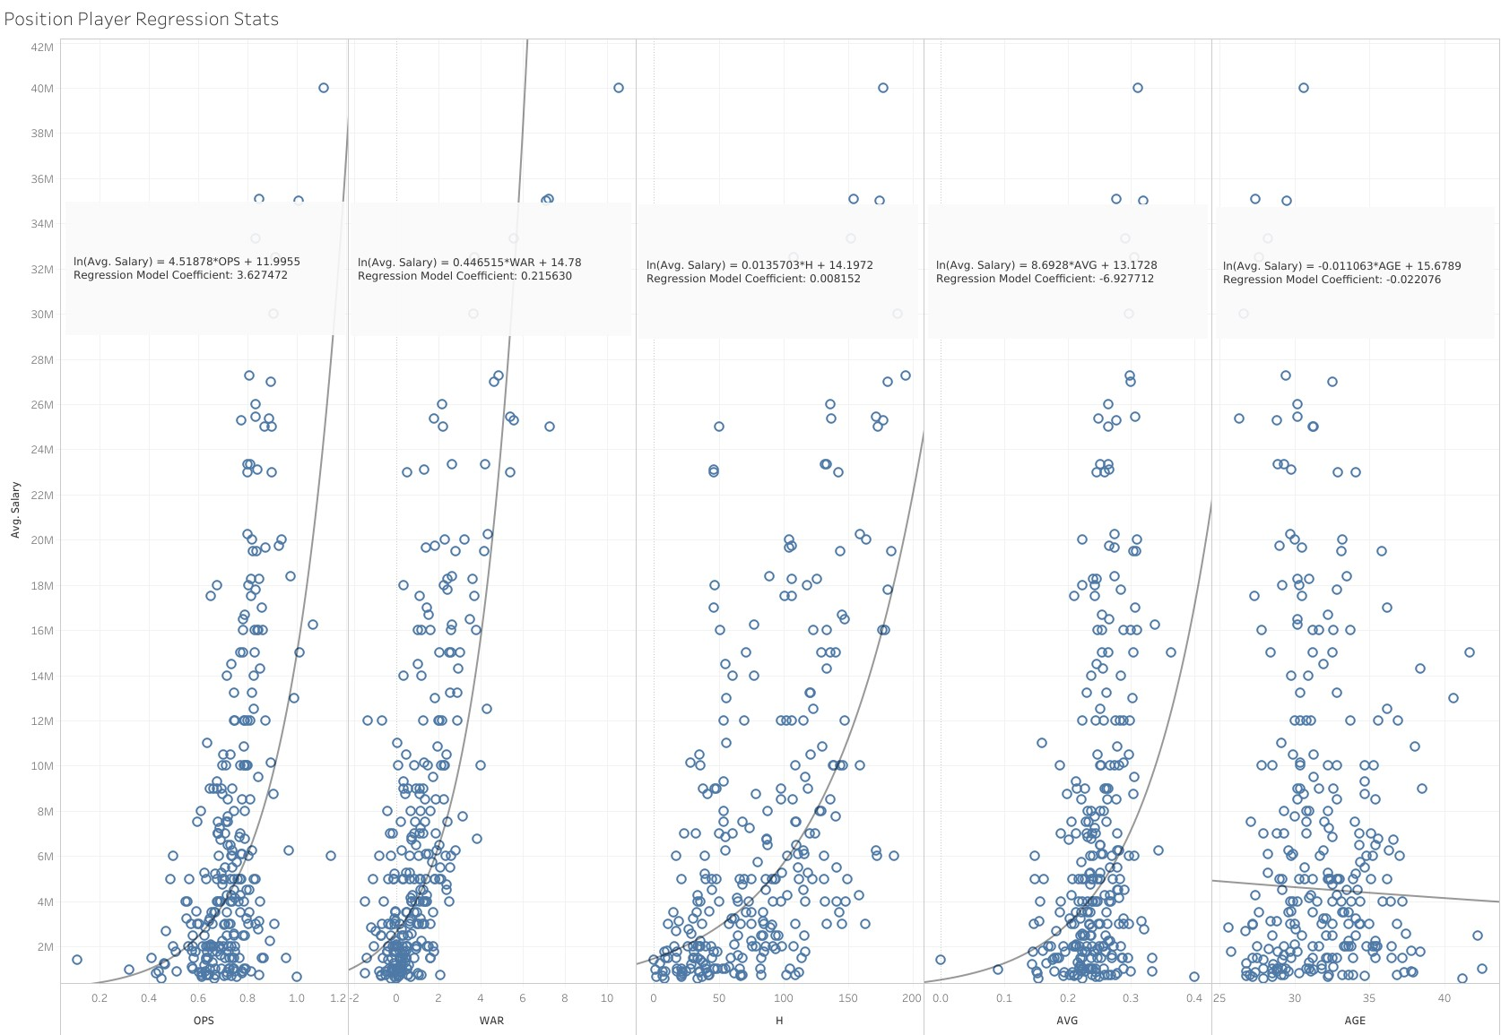
Exponential Regression coefficients vs actual Trend lines
Notes:
Again, we look at the coefficients we just found with the exp regression compared with plotted exp trendlines on all variables

Slide 27
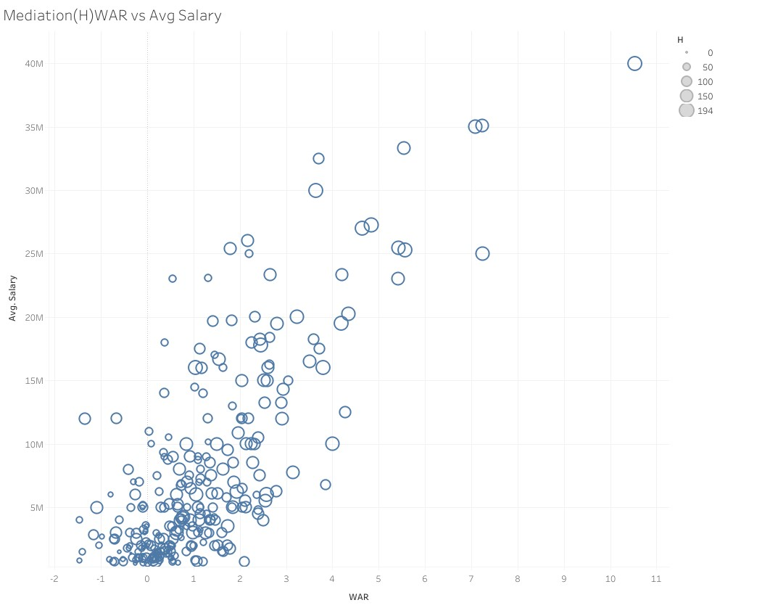
Mediation Analysis of H
Indirectly effects 30.30% WAR on Salary
Notes:
Only two mediators this time H and OPS

Slide 28
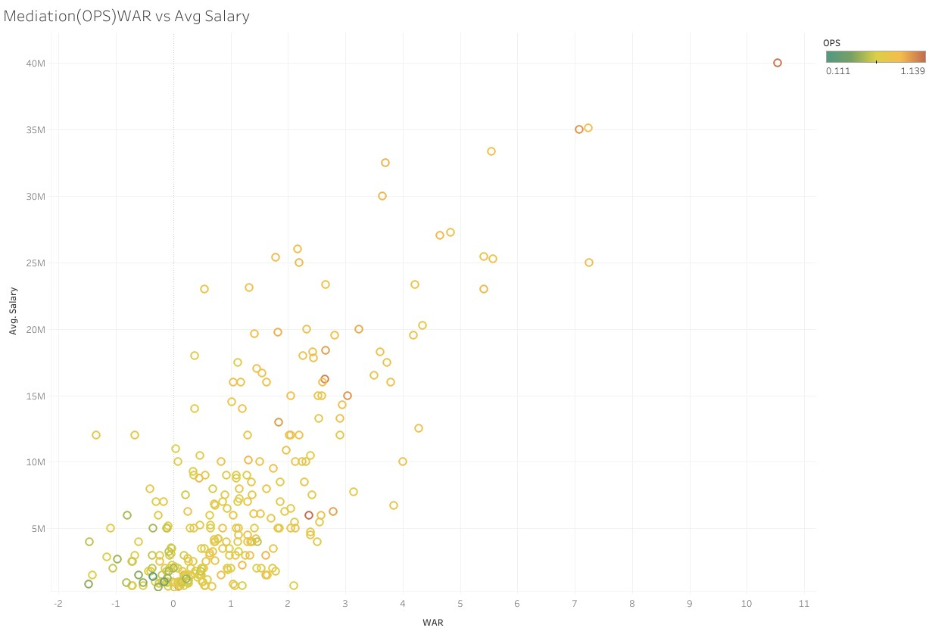
Mediation Analysis of OPS
Indirectly effects 17.05% WAR on Salary

Slide 29
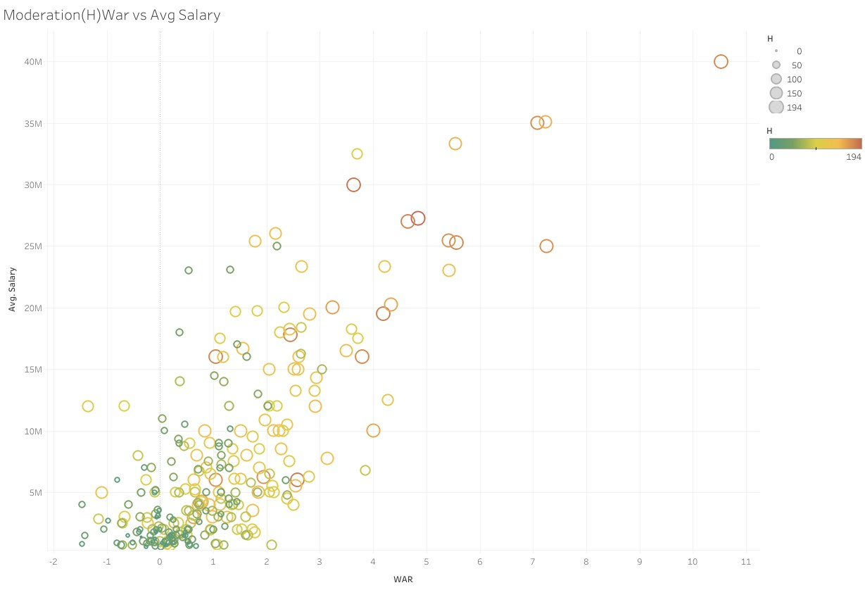
Moderation Analysis
H
Coefficient: -0.0018766
Influences 49.25% on WAR and Salary
Notes:
Only one moderator H

Slide 30
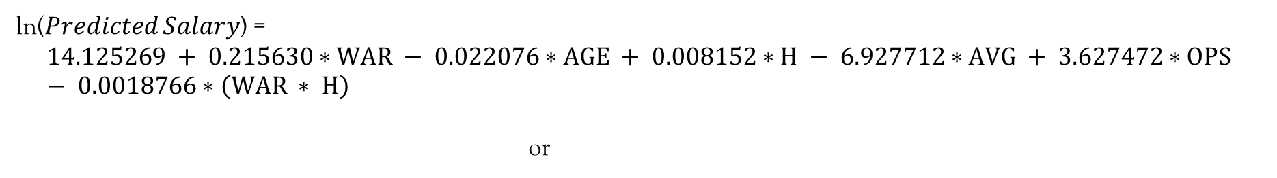
Prediction Equation
ln⁡(𝑃𝑟𝑒𝑑𝑖𝑐𝑡𝑒𝑑 𝑆𝑎𝑙𝑎𝑟𝑦) =
$$14.125269 + 0.215630∗WAR − 0.022076∗AGE + 0.008152∗H − 6.927712∗AVG + 3.627472∗OPS − 0.0018766∗\left(WAR ∗ H\right)$$
or
$$Predicted Salary=e^{(14.125269 + 0.215630∗WAR − 0.022076∗AGE + 0.008152∗H − 6.927712∗AVG + 3.627472∗OPS − 0.0018766∗\left(WAR ∗ H\right))}$$
Notes:
Now here is our Position player equation

Slide 31
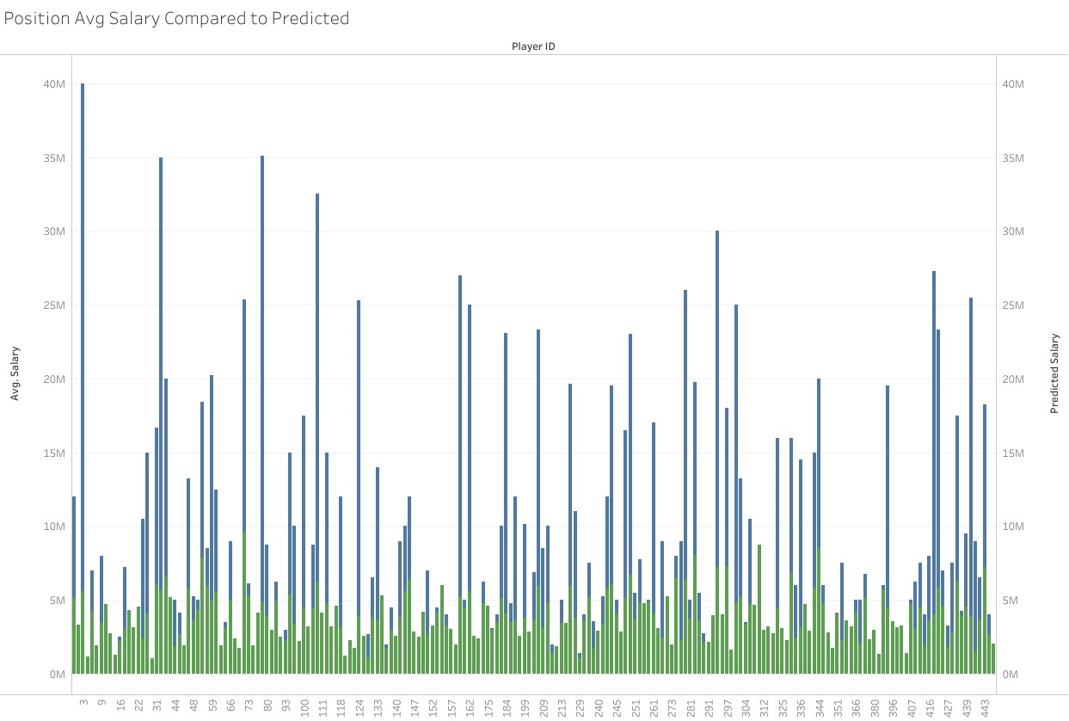
Comparison of Predicted vs. Actual

Slide 32

Position Error
Percent Error = ((Observed - Predicted)/Observed) *100%
Over the whole Position Player Dataset
Average Percent Error = - 8.75%
Standard Deviation = .09736621
Percent Difference = |Observed - Predicted|/[(Observed + Predicted)/2]
Over the whole Position Player Dataset
Average Percent Difference = 66%
Standard Deviation = .4149471
Notes:
Our model underestimates 8.75% of the time
While our spread is 66% off
Yeah, this needs fine tuning

Slide 33
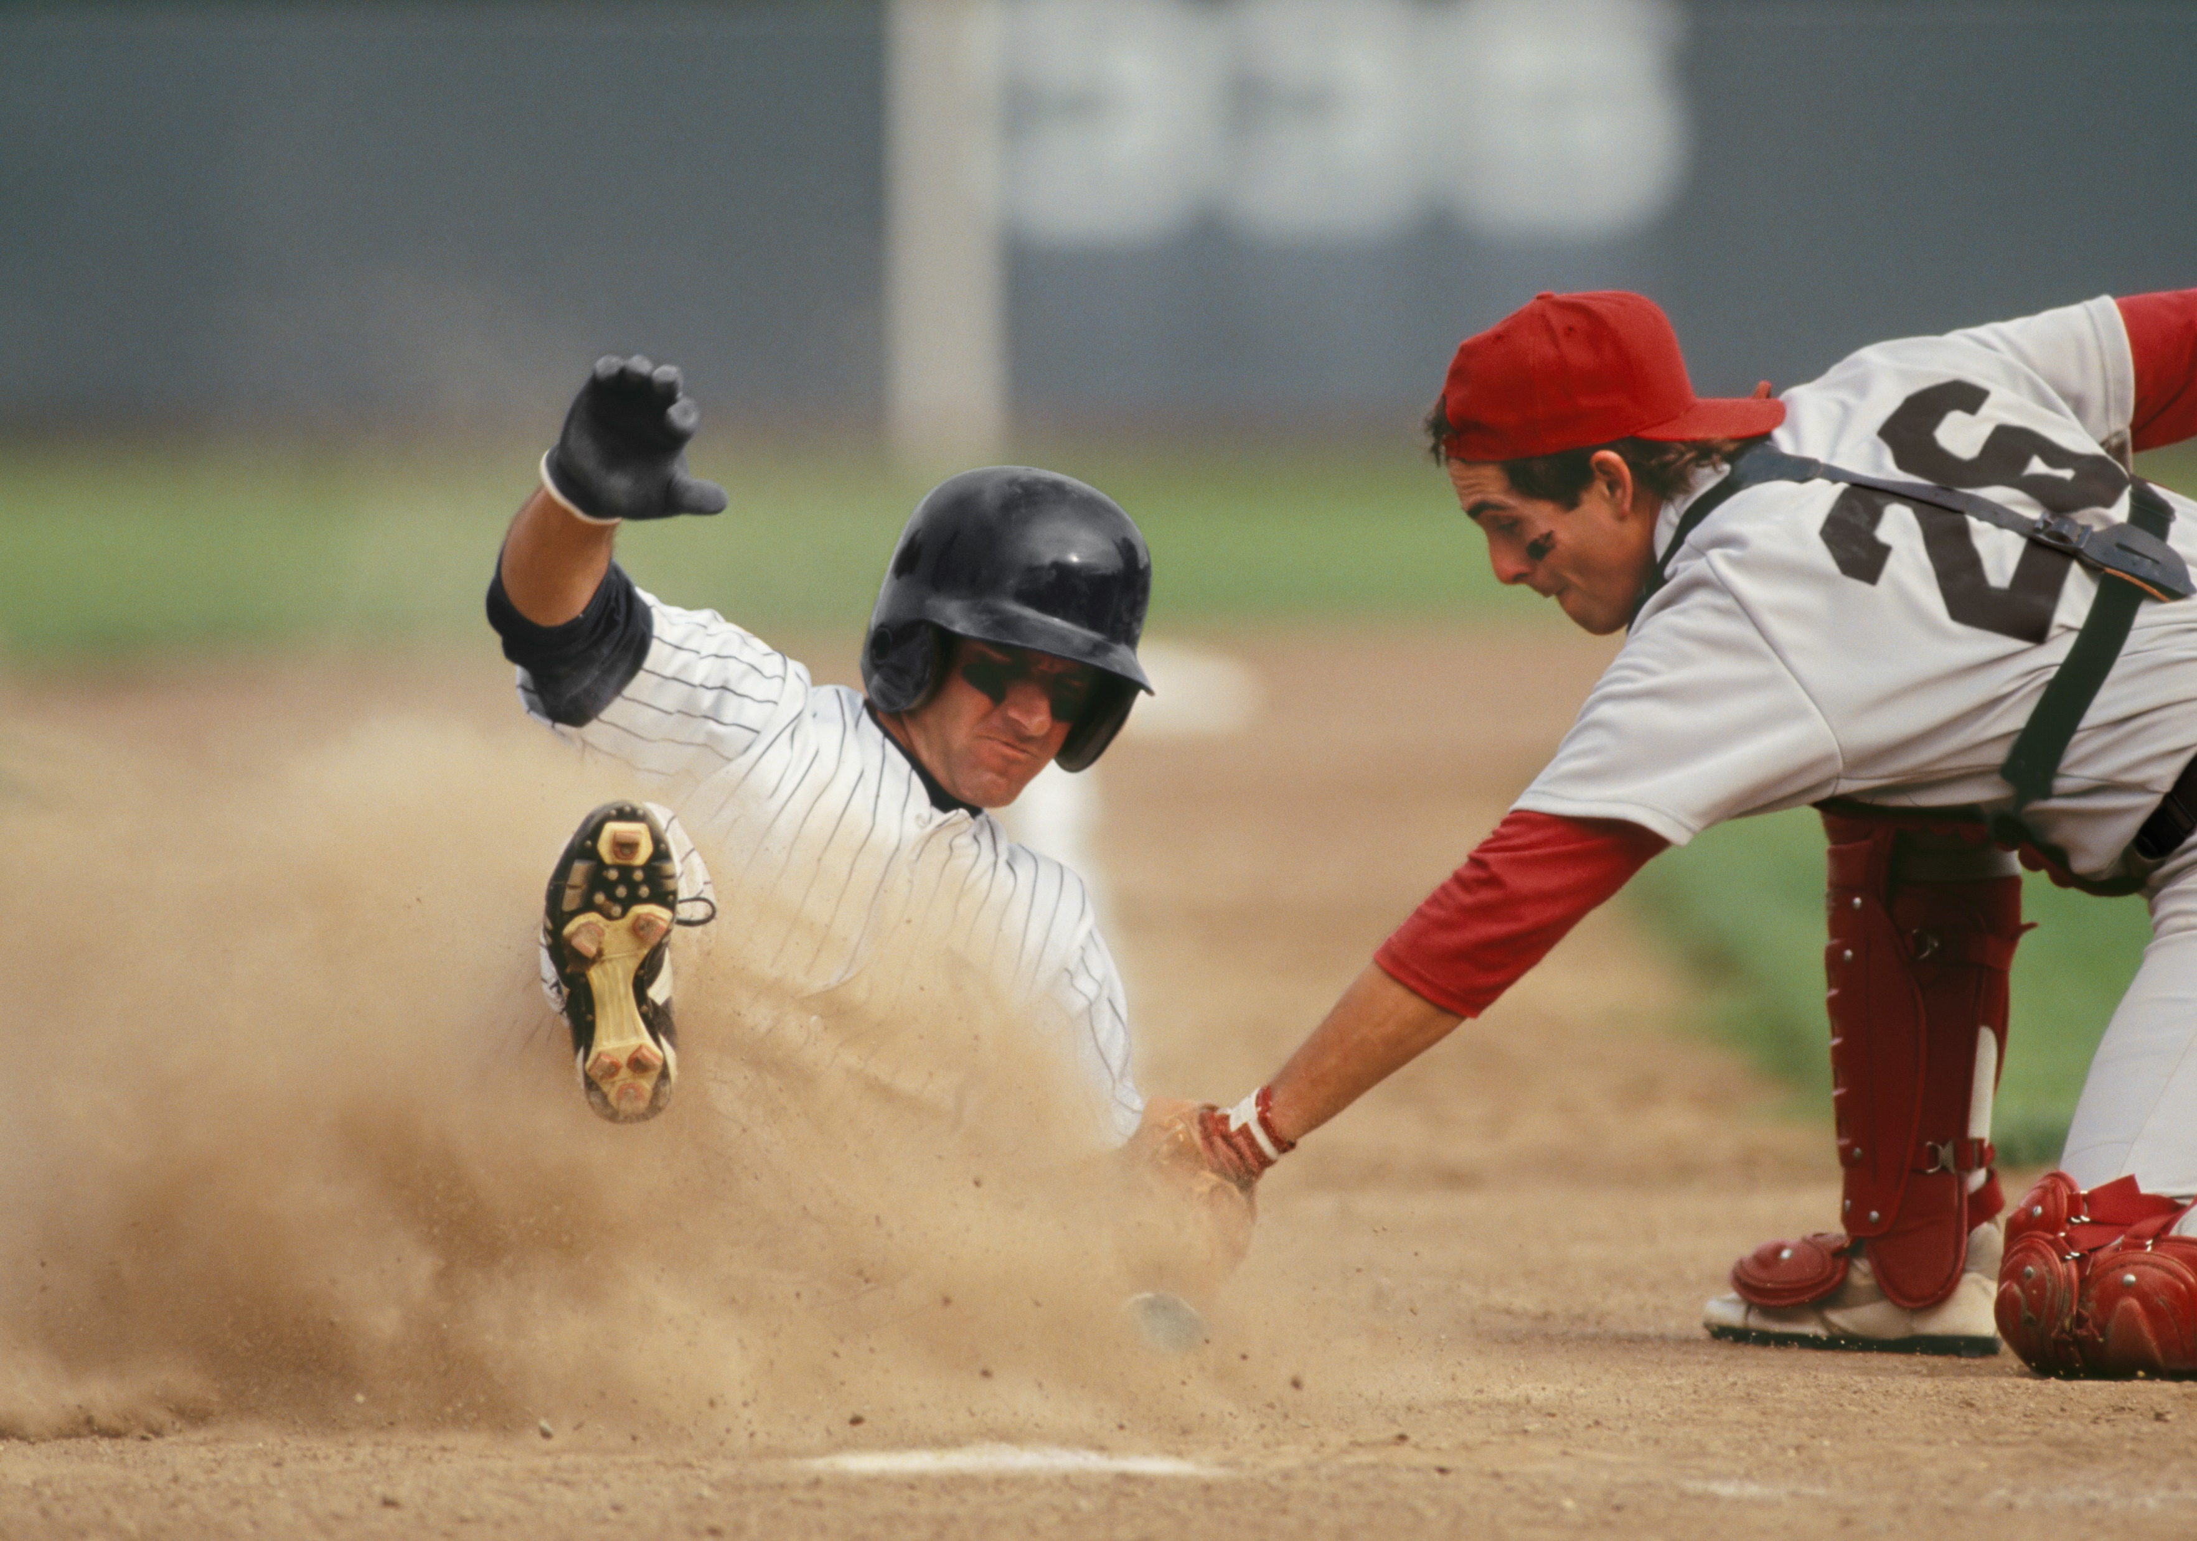
Summary
Pitcher
Average -13.44% underestimate
Average 65% difference between observed and predicted
Position Player
Average -8.75% underestimate
Average 66% difference between observed and predicted
Notes:
The model underestimates salaries on average and by a significant amount
Out of 331 pitchers 31(~1/10) were within 10% and 67 with 25%
Out of 278 position players 25(~1/12) were within 10%, and 58 within 25%
Or in baseball terms I’m batting .300

Slide 34
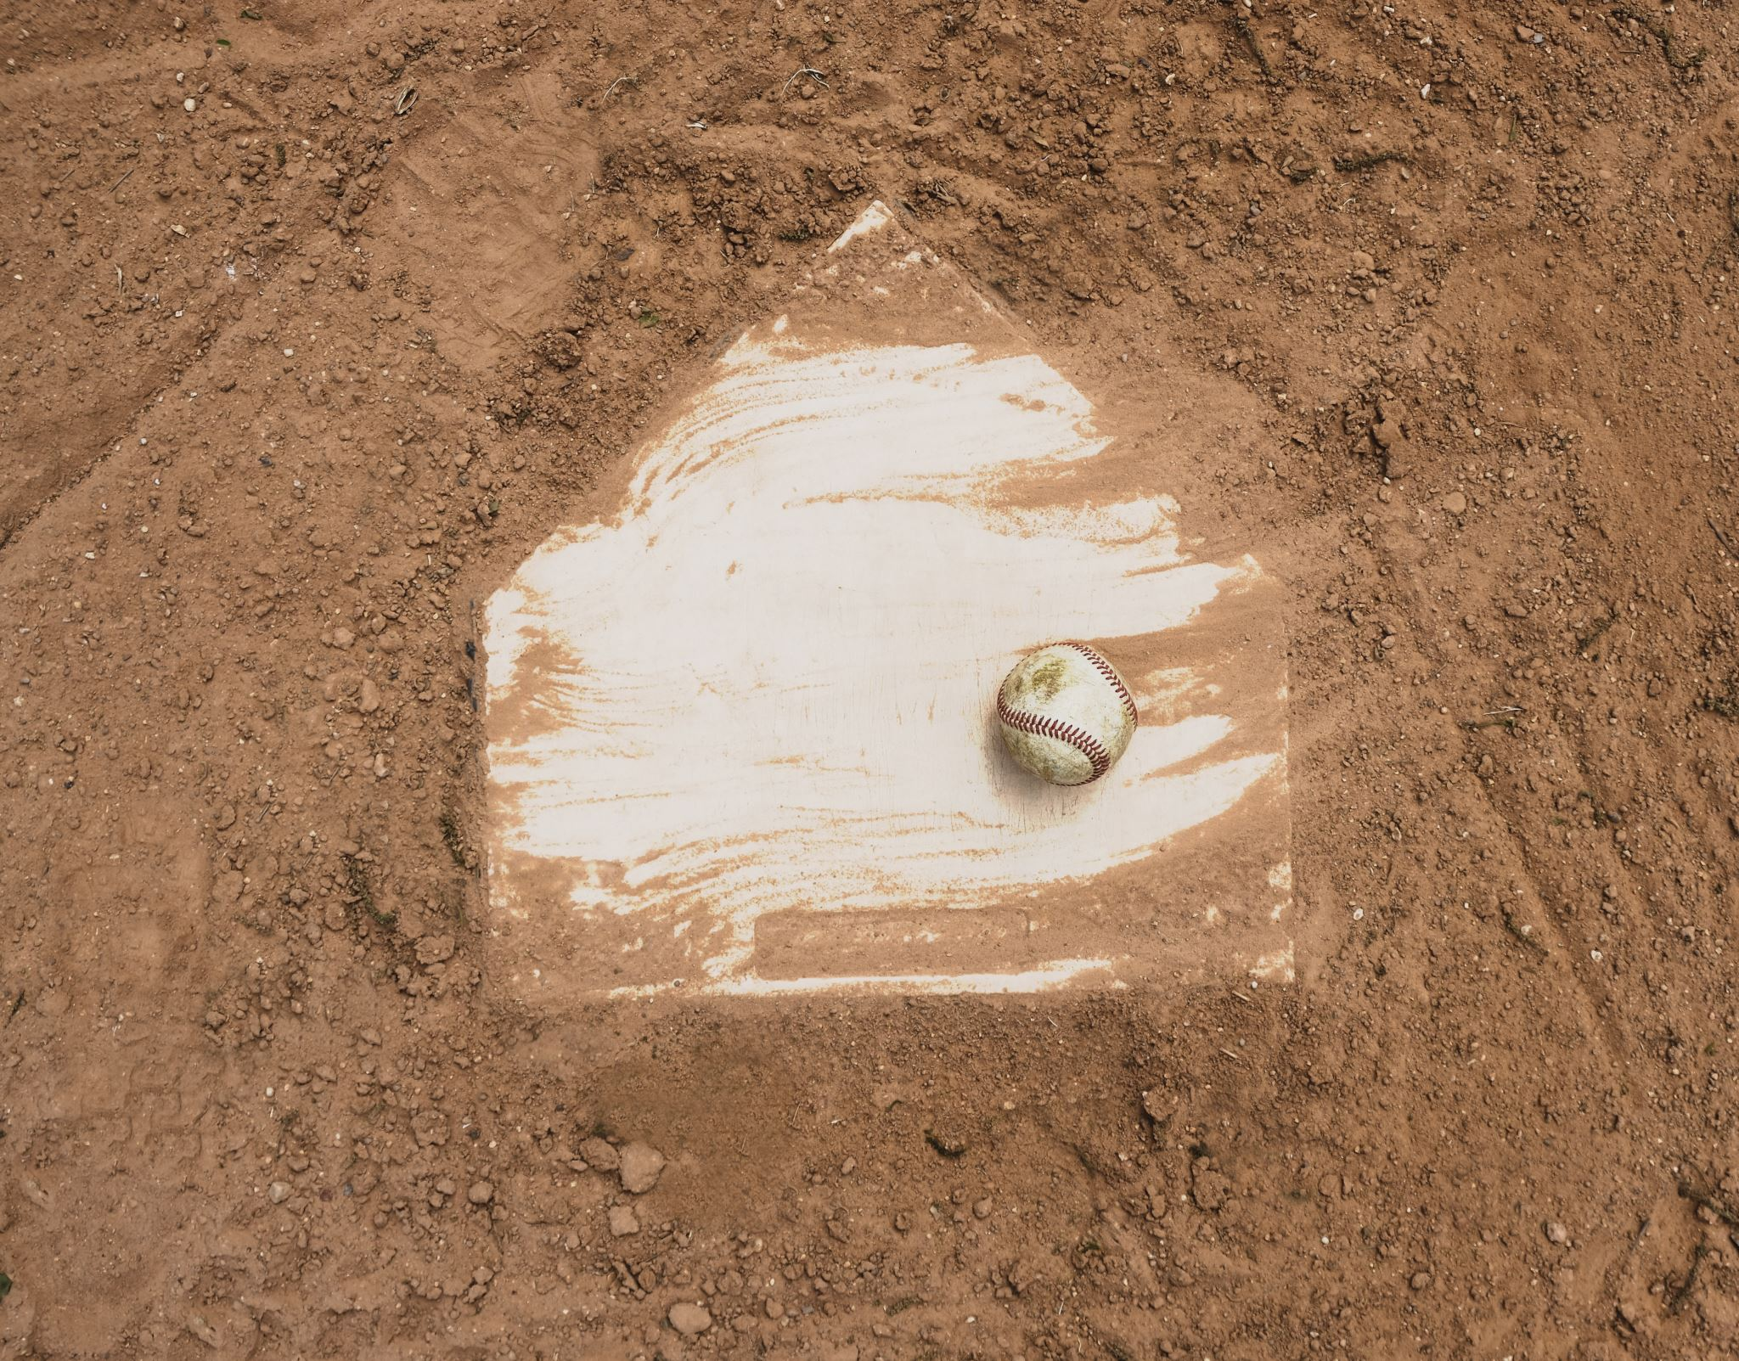
Conclusions
Modeling can help support salary prediction
Fine tuning is required
Adding other statistic variables
Different regression models
Comparison to linear regression model
Using lifetime statistics
There are unknowns that can't be accounted for
Negotiation process
Over valuation
Notes:
There are many other statistics that can be added and analyzed
Perhaps using a polynomic model or even a combination of models
There is the chance that a new statistic is need to analyze this properly
Over 100% error

Slide 35

Questions?

Slide 36
Citations
2024 MLB Free Agents Tracker. (n.d.). Spotrac.com. https://www.spotrac.com/mlb/free-agents/
Standard Stats | Glossary | MLB.com. (n.d.). MLB.com. https://www.mlb.com/glossary/standard-stats
Advanced Stats | Glossary | MLB.com. (n.d.). MLB.com. https://www.mlb.com/glossary/advanced-stats
Zach. (2021, October 4). Exponential regression in R (Step-by-Step). Statology. https://www.statology.org/exponential-regression-in-r/
Ravelo, C. (2022, November 23). Stepwise Regression: What is it and should you use it? Statistics Solutions. https://www.statisticssolutions.com/stepwise-regression-what-is-it-and-should-you-use-it/
Fein, E. C. (2022, June 16). Section 7.3: Moderation Models, Assumptions, Interpretation, and Write up. Pressbooks. https://usq.pressbooks.pub/statisticsforresearchstudents/chapter/moderation-assumptions/

